Slide 1
Straight Line and Circle
From a suggestion by Mark Richards (Lancaster Girls’ Grammar School)

Slide 2





Straight Line and Circle
$$y$$
What is the equation of the line that goes through the point shown and is also tangential to a circle centred at the origin $O$?
Write your answer in the form $ax+by=c^{2}$, where $a, b$and $c$ are integers.
What is the radius of the circle?
$$(p,q)$$
$$O$$
$$x$$

Slide 3

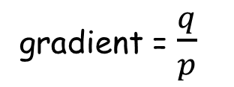

Straight Line and Circle
$$y$$
$$(p,q)$$
gradient = $\frac{−p}{q}$
gradient = $\frac{q}{p}$
$$O$$
$$x$$
“$m_{1}m_{2}=−1$“

Slide 4
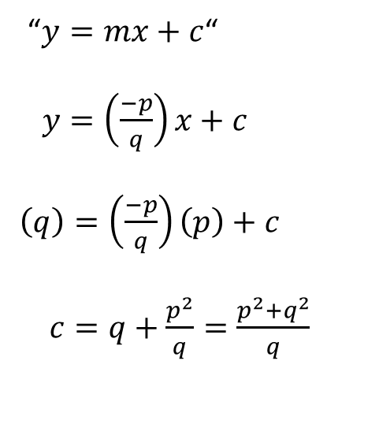
Straight Line and Circle
$$y$$
“$y=mx+c$“
$y=\left(\frac{−p}{q}\right)x+c$
$\left(q\right)=\left(\frac{−p}{q}\right)\left(p\right)+c$
$c=q+\frac{p^{2}}{q}=\frac{p^{2}+q^{2}}{q}$
$$(p,q)$$
gradient = $\frac{−p}{q}$
gradient = $\frac{q}{p}$
$$O$$
$$x$$

Slide 5

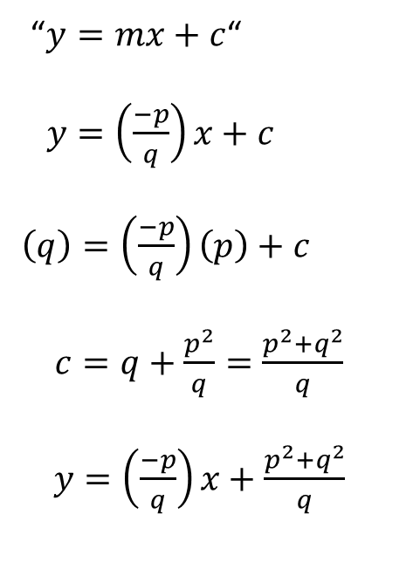
Straight Line and Circle
$$y$$
“$y=mx+c$“
$y=\left(\frac{−p}{q}\right)x+c$
$\left(q\right)=\left(\frac{−p}{q}\right)\left(p\right)+c$
$c=q+\frac{p^{2}}{q}=\frac{p^{2}+q^{2}}{q}$
$y=\left(\frac{−p}{q}\right)x+\frac{p^{2}+q^{2}}{q}$
$$(p,q)$$
$qy+px=p^{2}+q^{2}$
$$O$$
$$x$$

Slide 6

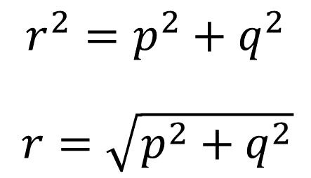



Straight Line and Circle
$$y$$
$${r^{2}=p}^{2}+q^{2}$$
$r=\sqrt{p^{2}+q^{2}}$
$$(p,q)$$
$$q$$
$qy+px=p^{2}+q^{2}$
$$r$$
$qy+px=r^{2}$
$$O$$
$$p$$
$$x$$

Slide 8
NOTE to TEACHER
All coordinates are the shorter lengths of Pythagorean triples.
The triples used are:
(3,4,5) (5,12,13) (7,24,25) (8,15,17)
(9,40,41) (11,60,61) (12,35,37) (13,84,85)
(15,112,113) (20,21,29) (60,221,229) (88,105,137)

Slide 9
RESOURCES

Slide 10




SIC_58
Straight Line and Circle
What is the equation of the line that goes through the point shown and is also tangential to a circle centred at the origin $O$?
Write your answer in the form $ax+by=c^{2}$, where $a, b$and $c$ are integers.
What is the radius of the circle?
$$y$$
$$(3,4)$$
(Not drawn to scale)
$$O$$
$$x$$

Slide 11

SIC_58
Straight Line and Circle
What is the equation of the line that goes through the point shown and is also tangential to a circle centred at the origin $O$?
Write your answer in the form $ax+by=c^{2}$, where $a, b$and $c$ are integers.
What is the radius of the circle?
$$y$$
$$(5,12)$$
(Not drawn to scale)
$$O$$
$$x$$

Slide 12

SIC_58
Straight Line and Circle
What is the equation of the line that goes through the point shown and is also tangential to a circle centred at the origin $O$?
Write your answer in the form $ax+by=c^{2}$, where $a, b$and $c$ are integers.
What is the radius of the circle?
$$y$$
$$(7,24)$$
(Not drawn to scale)
$$O$$
$$x$$

Slide 13

SIC_58
Straight Line and Circle
What is the equation of the line that goes through the point shown and is also tangential to a circle centred at the origin $O$?
Write your answer in the form $ax+by=c^{2}$, where $a, b$and $c$ are integers.
What is the radius of the circle?
$$y$$
$$(8,15)$$
(Not drawn to scale)
$$O$$
$$x$$

Slide 14

SIC_58
Straight Line and Circle
What is the equation of the line that goes through the point shown and is also tangential to a circle centred at the origin $O$?
Write your answer in the form $ax+by=c^{2}$, where $a, b$and $c$ are integers.
What is the radius of the circle?
$$y$$
$$(9,40)$$
(Not drawn to scale)
$$O$$
$$x$$

Slide 15

SIC_58
Straight Line and Circle
What is the equation of the line that goes through the point shown and is also tangential to a circle centred at the origin $O$?
Write your answer in the form $ax+by=c^{2}$, where $a, b$and $c$ are integers.
What is the radius of the circle?
$$y$$
$$(11,60)$$
(Not drawn to scale)
$$O$$
$$x$$

Slide 16

SIC_58
Straight Line and Circle
What is the equation of the line that goes through the point shown and is also tangential to a circle centred at the origin $O$?
Write your answer in the form $ax+by=c^{2}$, where $a, b$and $c$ are integers.
What is the radius of the circle?
$$y$$
$$(12,35)$$
(Not drawn to scale)
$$O$$
$$x$$

Slide 17

SIC_58
Straight Line and Circle
What is the equation of the line that goes through the point shown and is also tangential to a circle centred at the origin $O$?
Write your answer in the form $ax+by=c^{2}$, where $a, b$and $c$ are integers.
What is the radius of the circle?
$$y$$
$$(13,84)$$
(Not drawn to scale)
$$O$$
$$x$$

Slide 18

SIC_58
Straight Line and Circle
What is the equation of the line that goes through the point shown and is also tangential to a circle centred at the origin $O$?
Write your answer in the form $ax+by=c^{2}$, where $a, b$and $c$ are integers.
What is the radius of the circle?
$$y$$
$$(15,112)$$
(Not drawn to scale)
$$O$$
$$x$$

Slide 19

SIC_58
Straight Line and Circle
What is the equation of the line that goes through the point shown and is also tangential to a circle centred at the origin $O$?
Write your answer in the form $ax+by=c^{2}$, where $a, b$and $c$ are integers.
What is the radius of the circle?
$$y$$
$$(20,21)$$
(Not drawn to scale)
$$O$$
$$x$$

Slide 20

SIC_58
Straight Line and Circle
What is the equation of the line that goes through the point shown and is also tangential to a circle centred at the origin $O$?
Write your answer in the form $ax+by=c^{2}$, where $a, b$and $c$ are integers.
What is the radius of the circle?
$$y$$
$$(60,221)$$
(Not drawn to scale)
$$O$$
$$x$$

Slide 21

SIC_58
Straight Line and Circle
What is the equation of the line that goes through the point shown and is also tangential to a circle centred at the origin $O$?
Write your answer in the form $ax+by=c^{2}$, where $a, b$and $c$ are integers.
What is the radius of the circle?
$$y$$
$$(88,105)$$
(Not drawn to scale)
$$O$$
$$x$$

Slide 22

SIC_58
Straight Line and Circle
What is the equation of the line that goes through the point shown and is also tangential to a circle centred at the origin $O$?
Write your answer in the form $ax+by=c^{2}$, where $a, b$and $c$ are integers.
What is the radius of the circle?
$$y$$
$$(4,3)$$
(Not drawn to scale)
$$O$$
$$x$$

Slide 23

SIC_58
Straight Line and Circle
What is the equation of the line that goes through the point shown and is also tangential to a circle centred at the origin $O$?
Write your answer in the form $ax+by=c^{2}$, where $a, b$and $c$ are integers.
What is the radius of the circle?
$$y$$
$$(12,5)$$
(Not drawn to scale)
$$O$$
$$x$$

Slide 24

SIC_58
Straight Line and Circle
What is the equation of the line that goes through the point shown and is also tangential to a circle centred at the origin $O$?
Write your answer in the form $ax+by=c^{2}$, where $a, b$and $c$ are integers.
What is the radius of the circle?
$$y$$
$$(24,7)$$
(Not drawn to scale)
$$O$$
$$x$$

Slide 25

SIC_58
Straight Line and Circle
What is the equation of the line that goes through the point shown and is also tangential to a circle centred at the origin $O$?
Write your answer in the form $ax+by=c^{2}$, where $a, b$and $c$ are integers.
What is the radius of the circle?
$$y$$
$$(15,8)$$
(Not drawn to scale)
$$O$$
$$x$$

Slide 26

SIC_58
Straight Line and Circle
What is the equation of the line that goes through the point shown and is also tangential to a circle centred at the origin $O$?
Write your answer in the form $ax+by=c^{2}$, where $a, b$and $c$ are integers.
What is the radius of the circle?
$$y$$
$$(40,9)$$
(Not drawn to scale)
$$O$$
$$x$$

Slide 27

SIC_58
Straight Line and Circle
What is the equation of the line that goes through the point shown and is also tangential to a circle centred at the origin $O$?
Write your answer in the form $ax+by=c^{2}$, where $a, b$and $c$ are integers.
What is the radius of the circle?
$$y$$
$$(60,11)$$
(Not drawn to scale)
$$O$$
$$x$$

Slide 28

SIC_58
Straight Line and Circle
What is the equation of the line that goes through the point shown and is also tangential to a circle centred at the origin $O$?
Write your answer in the form $ax+by=c^{2}$, where $a, b$and $c$ are integers.
What is the radius of the circle?
$$y$$
$$(35,12)$$
(Not drawn to scale)
$$O$$
$$x$$

Slide 29

SIC_58
Straight Line and Circle
What is the equation of the line that goes through the point shown and is also tangential to a circle centred at the origin $O$?
Write your answer in the form $ax+by=c^{2}$, where $a, b$and $c$ are integers.
What is the radius of the circle?
$$y$$
$$(84,13)$$
(Not drawn to scale)
$$O$$
$$x$$

Slide 30

SIC_58
Straight Line and Circle
What is the equation of the line that goes through the point shown and is also tangential to a circle centred at the origin $O$?
Write your answer in the form $ax+by=c^{2}$, where $a, b$and $c$ are integers.
What is the radius of the circle?
$$y$$
$$(112,15)$$
(Not drawn to scale)
$$O$$
$$x$$

Slide 31
SIC_58
Straight Line and Circle
What is the equation of the line that goes through the point shown and is also tangential to a circle centred at the origin $O$?
Write your answer in the form $ax+by=c^{2}$, where $a, b$and $c$ are integers.
What is the radius of the circle?
$$y$$
$$(20,21)$$
(Not drawn to scale)
$$O$$
$$x$$

Slide 32

SIC_58
Straight Line and Circle
What is the equation of the line that goes through the point shown and is also tangential to a circle centred at the origin $O$?
Write your answer in the form $ax+by=c^{2}$, where $a, b$and $c$ are integers.
What is the radius of the circle?
$$y$$
$$(221,60)$$
(Not drawn to scale)
$$O$$
$$x$$

Slide 33

SIC_58
Straight Line and Circle
What is the equation of the line that goes through the point shown and is also tangential to a circle centred at the origin $O$?
Write your answer in the form $ax+by=c^{2}$, where $a, b$and $c$ are integers.
What is the radius of the circle?
$$y$$
$$(105,88)$$
(Not drawn to scale)
$$O$$
$$x$$

